Slide 1

Predictive Performance Analysis of Airbnb Matrix
Emmanuel Osayande Aghedo
Viva Presentation
Department of Computer Science and Creative Technologies
Faculty of Environment and Technology
University of the West of England
Student ID: 23016468

Slide 2
Introduction
Airbnb is an online platform that allows people to rent out their homes, apartments, or other properties to travellers looking for short-term accommodations.
The company was founded in 2008 and has since grown into one of the largest and well-known names in the hospitality and travel industry.

Slide 3
Scope: Develop an integrated, data-driven framework to derive value from Airbnb data.
Project Objectives.
Objective 1: Prediction Model
Develop a predictive model to predict optimal listings price and identify influential attributes.
Objective 2: Sentiment analysis
Analyze guest reviews and satisfaction to quantify relationship with performance trends.
Objective 3: Recommender system
Implement collaborative filtering for optimized guest discovery based on listings traits.
Objective 4: Actionable insights
Synthesises output into an interactive tool.

Slide 4
Motivation / Project Rational.
Problem
Solution
The Goal
Host: Relies mostly on social learning; lack sophisticated Pricing tools.
Guests: Face information overload and difficulty assessing listing quality.
Predictive modelling: Actionable price predictions to optimize host revenue.
Recommender System: Personalised filtering to simplify the guest journey.
Previous research has treated price prediction and recommendation system problem separately, their integration is key to holistic marketplace experience.
A unified analytical framework for the Dublin market.

Slide 5
Data Description
Reviews Dataset (reviews.csv)
Contents: Historical guest feedback and timestamps.
Key Features: Reviewer ID, Date, and Comment text.
Source: Inside Airbnb, a mission-driven, grassroots project providing transparent, non-commercial rental data.
Context: Dublin was selected due to its high-density tourism profile and complex real estate market.
Dataset Scope: The research utilizes two primary relational datasets:
Listings Dataset (listings.csv)
Contents: Detailed attributes of each property.
Key Features: Price, location (coordinates), Host characteristics property type, room type, and review scores.

Slide 6
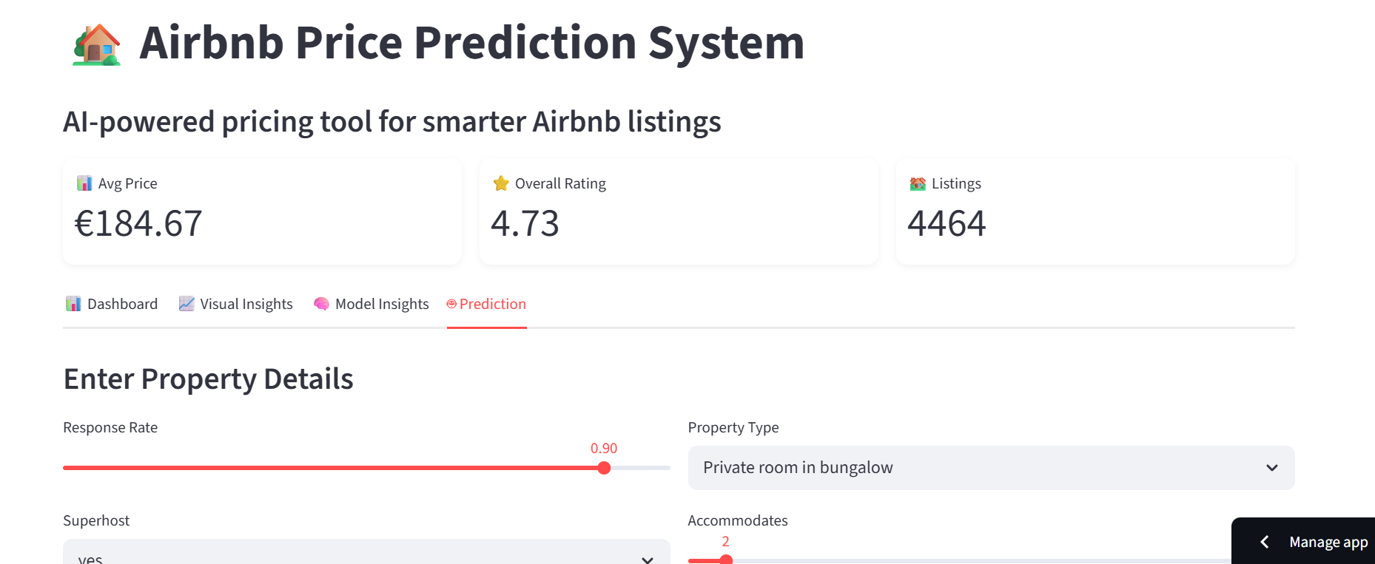
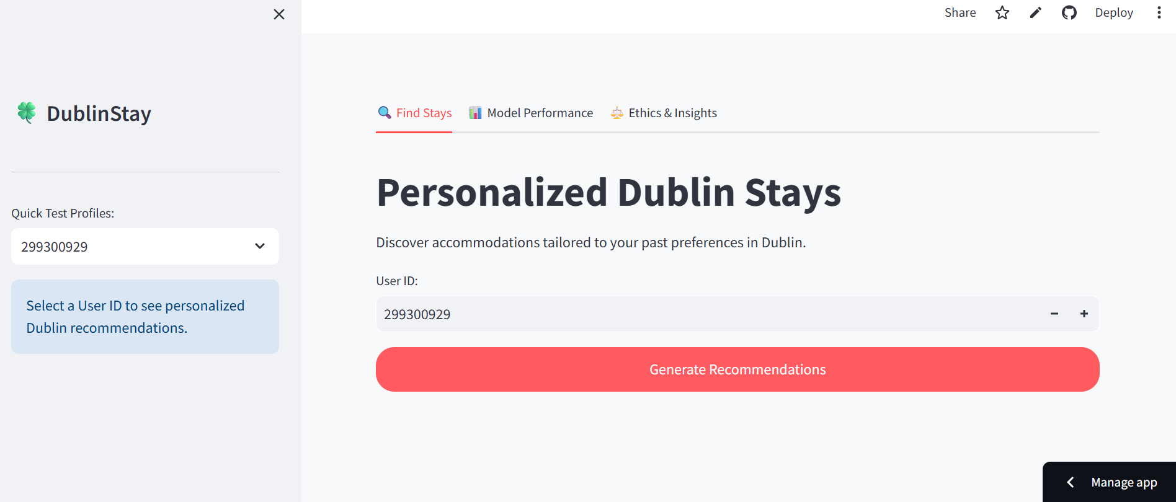
Interactive Dashboard (Artefact)
Price Prediction
https://predictiveperformanceanalysisofairbnbmetrics-4asnlpyjsjc42588x.streamlit.app/
Recommendation System
https://predictiveperformanceanalysisofairbnbmetrics-8bysfmucc3l2hpevc.streamlit.app

Slide 7
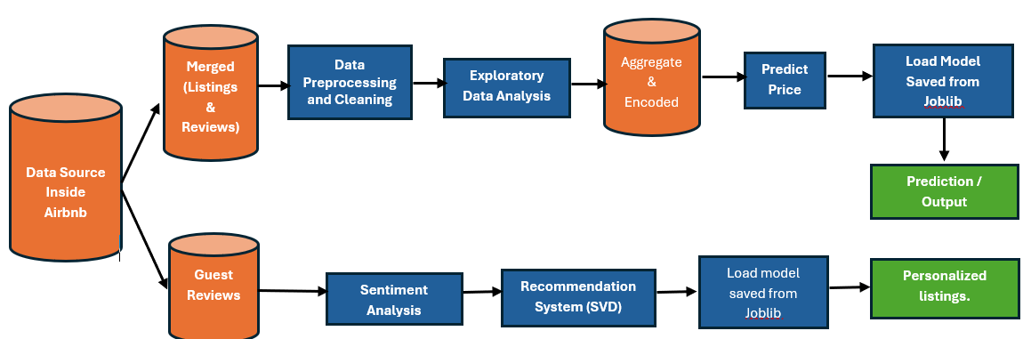
Methodology & Work Flow
Data split
test_size=0.2, random_state=42

Slide 8
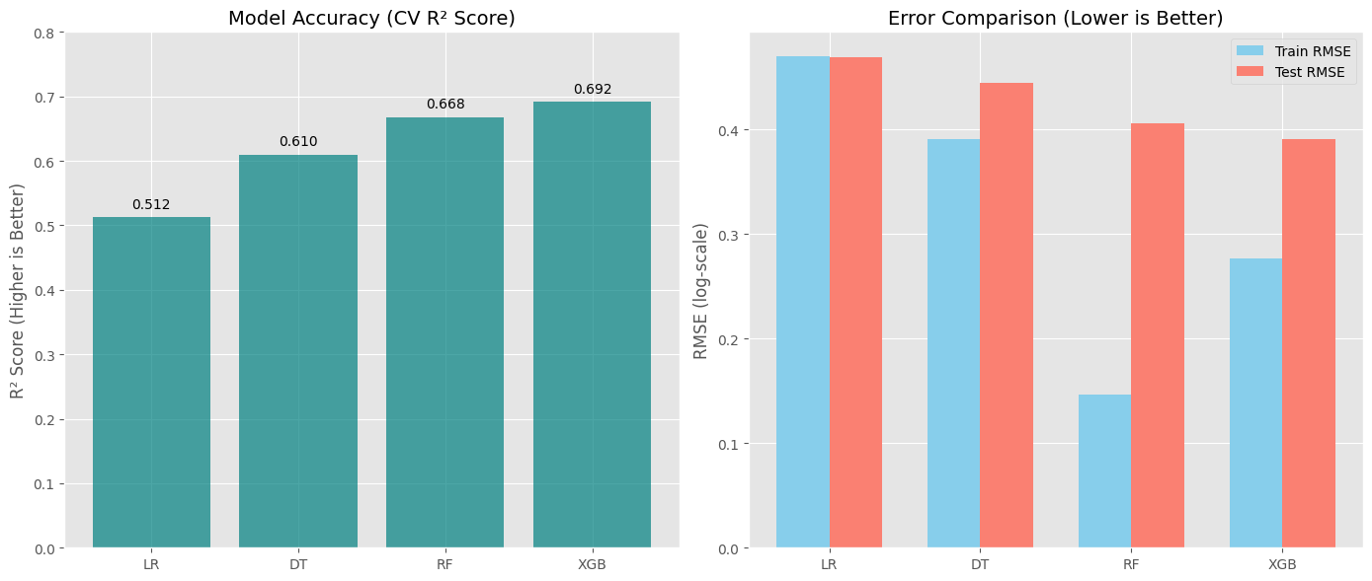
Result and Conclusion
Price Prediction Model

Slide 9
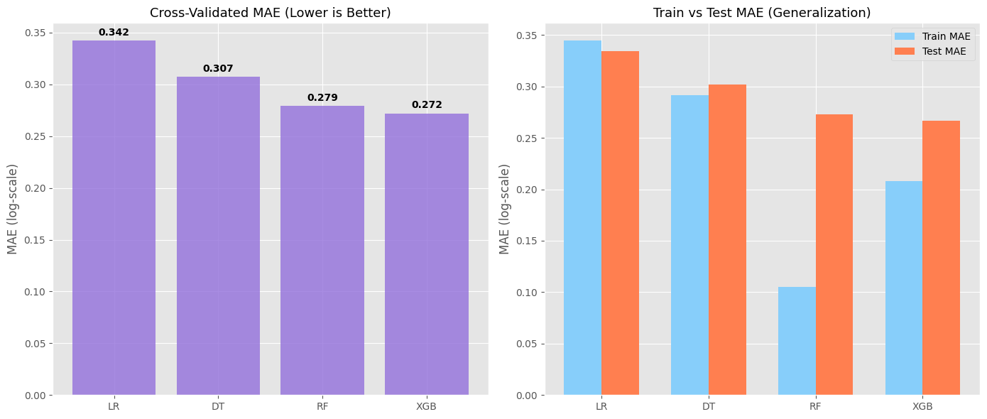
Result and Conclusion
Price Prediction Model

Slide 10
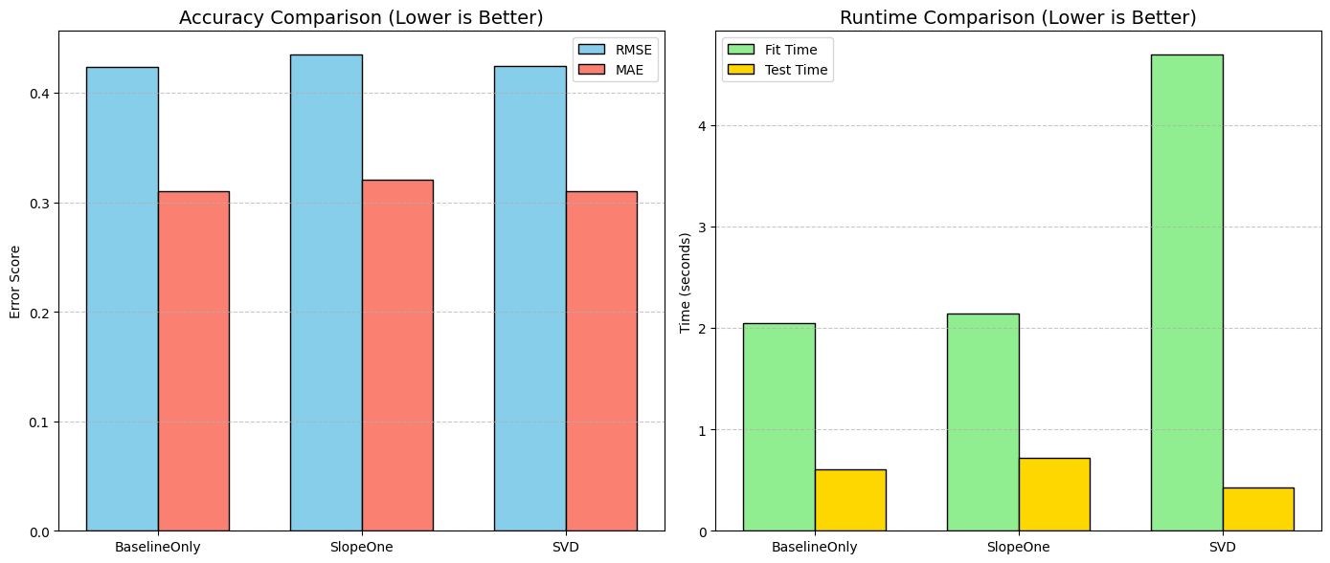
Result and Conclusion
Recommendation System

Slide 11
Benefits / Limitation
Benefits of price prediction
Revenue Optimization
Market Alignment
Real time decision support
Interpretability
Benefits of Recommendation system
Personalization
Reduced search time
Better Decision making
Business impact
Limitations of Price
Lack of external factors
Potential bias in historical data
The model may not generalize well outside dublin
These could be addressed in future work with richer data sets
Limitations of Recommendation system
Cold start problems for new users
Dependance on historical interaction data
Lack of contextual factors like time or intent
These could be improved by introducing hybrid recommendation approaches.

Slide 12
Future Work / Tech Stack
Future Work
implement deep learning approaches (e.g., neural collaborative filtering)
Expand analysis to multiple cities.
Incorporate real-time dynamic pricing
Develop hybrid recommendation systems
Tech Stack
Python (Pandas, NumPy, Scikit-learn)
XGBoost
Surprise Library
NLP (Sentiment Analysis)
Streamlit

Slide 13
Any questions?

Slide 14
Thank you!
aghedoemmanuel67@yahoo.com

